Slide 1








Optimal DG Placement in Distribution Networks
Leveraging visualization platform to understand Power transmission efficiency in Distribution network.
Presented by-
Ankesh Kumar
NU ID - 002208893
Course Project - EECE – 5642 (Data Visualization)
Submitted to- Prof. Raymond Fu

Slide 2

INTRODUCTION

Slide 3

INTRODUCTION
The project aims to system planner to decide effect of placement of small power generating units using the tool.
Optimal DG placement leads to enhance system efficiency of reduces the power loss.

Slide 4

OBJECTIVE

Slide 5
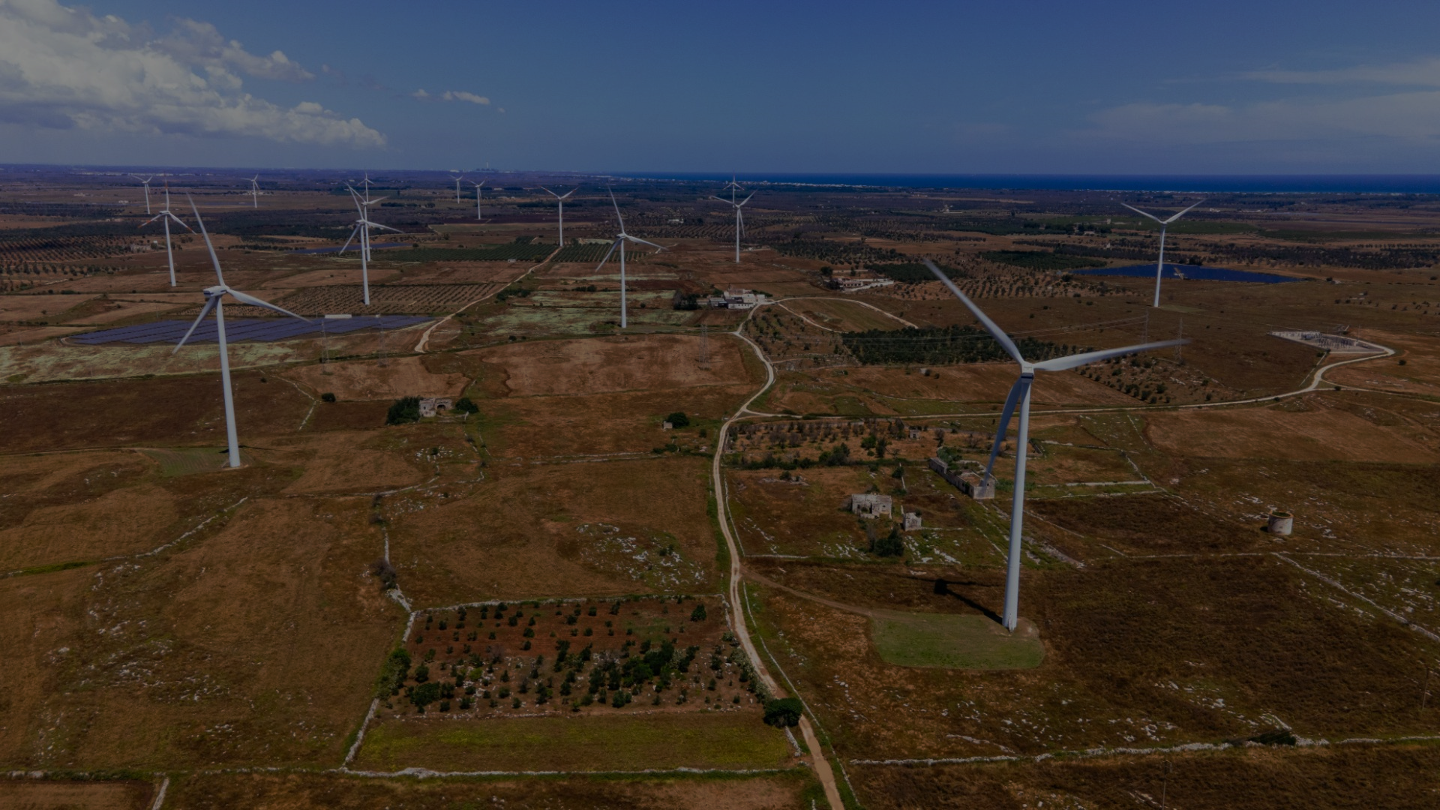
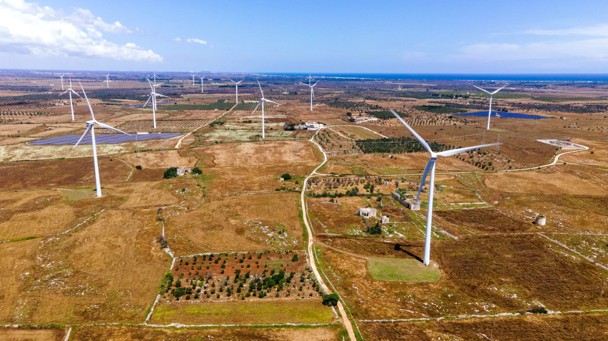

OBJECTIVE
For visualizing the distribution network, showcasing overall power system loss metrics, and evaluating deviation and stability indexes.
To create an interactive platform that enables users to install Distributed Generations (DGs) within the network, assessing their impact on system metrics either improving or deteriorating them.
To find an optimal solution for a complex, non-linear problem statement while minimizing computational resource requirements.

Slide 6
USE CASES
Utility Companies can leverage the tool for network planning and optimization.
Energy Planners and Consultants can use it for strategic planning and conducting feasibility studies.
Renewable Energy Developers can benefit from the tool in project development and investment justification.
Academic and Research Institutions for practical insights.

Slide 7

PROJECT
COMPONENTS

Slide 8

PROJECT
COMPONENTS
Tools used -
- MATLAB: Computational modeling.
- Python: Data processing and analysis.
- Streamlit: Interactive web app development supported by Python.
- Pandas & NumPy: Data manipulation, loading and for computational processes.
- Altair, Plotly – Visualization tools for generating charts, plots etc.

Slide 9
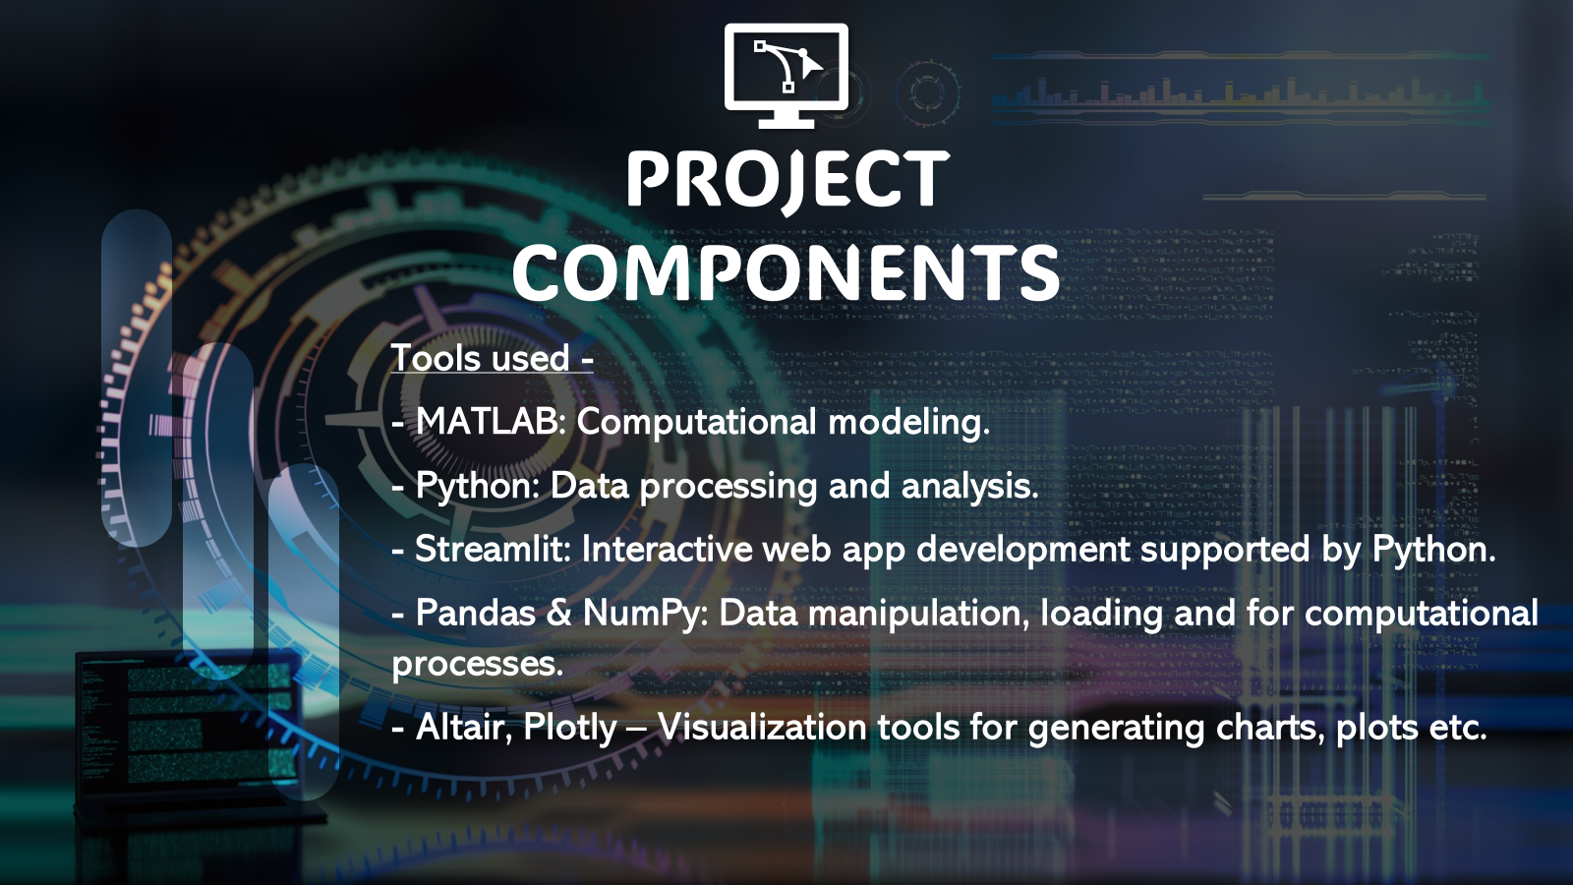
PROJECT
COMPONENTS
Stages -
Planning constraints and limitations.
Mathematical Modelling and Data Collection.
Reading data and creating different charts.
Using Streamlit to showcase results.
Rectifying the visualization
Test system – Mod-16 bus, 33 bus, 69 bus IEEE system
Whole project was divided into 3 Phases…

Slide 10

Phase 1 - Visualize Your Network
Collected data by running the Load Flow.
Program, initially takes input of type of Network configuration and presents
Network diagram – Graph representation
Standard Metrics of the system (Base case - Power Losses)
Bar graph for Voltage Deviation at each bus.
Gauge meter to see voltage Stability Index of the system.

Slide 11
Phase 2 - Design Your Network
In this phase, we run Load flow equations with DG installed (Type 1- Solar (+P) ) and generate datasets.
User input – Bus Number, DG Size
According to the provided data, the tool provides the following data
Mesh Grid – To understand why we need optimum solution and where your solution lies !!
System Parameters Active Power , Reactive Power and Apparent Power with percentage increase or decrease with color green if losses reduced.
New Voltage Deviation Index and Green signal if deviation if minimized else red.
New Voltage Stability Index and Green if index is maximized else red.

Slide 12
Phase 3 - Optimal DG Placement
Here I introduce the concept to find the optimal solution using the computation.
User can choose,
- how he want to approach the solution (Exhaustive Search vs. PSO).
- Range of DG (only +P) user wants to install
Output -
Tool Provides the optimum solution (Highest Active loss reduction for Bus and Size within specified/ input limits.
Other system parameters.
Animated Scatter Plot based on the computation method choosen to understand the computational behavior of search method selected.

Slide 13

PROJECT DEMO

Slide 14

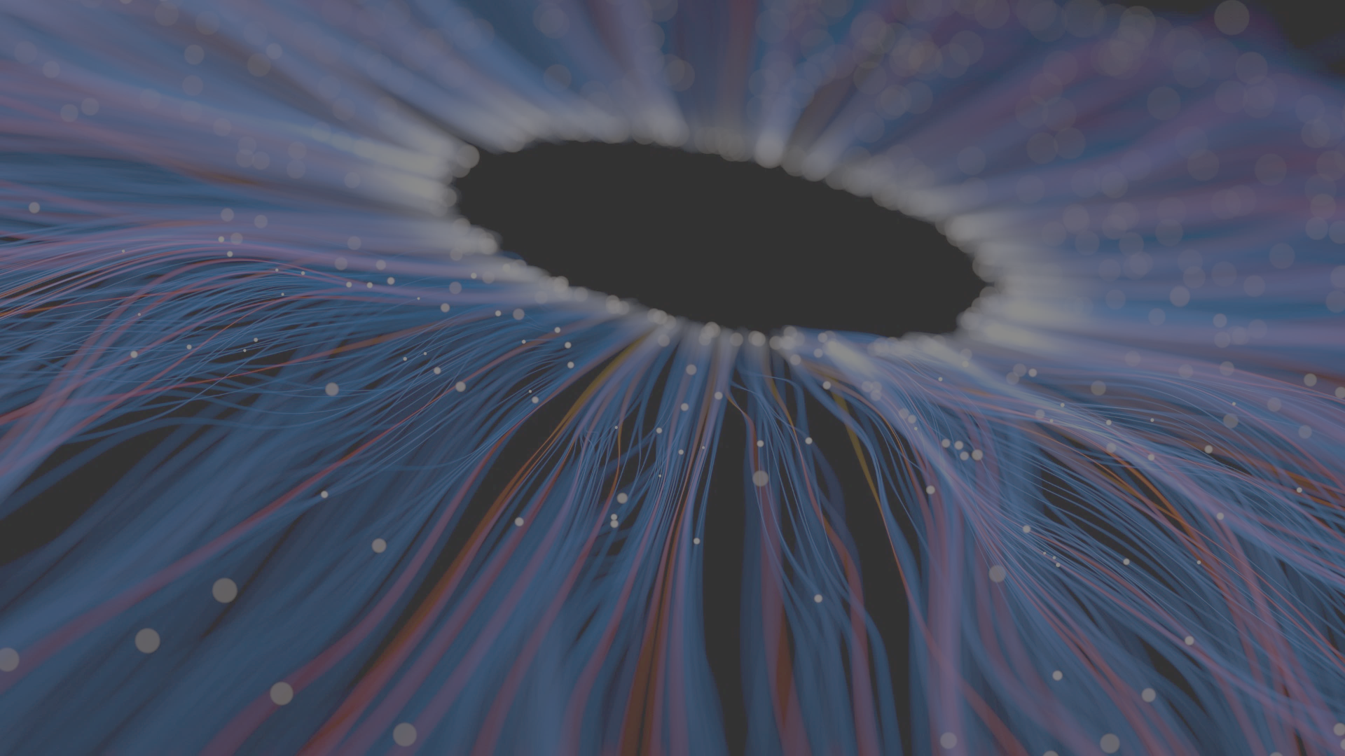
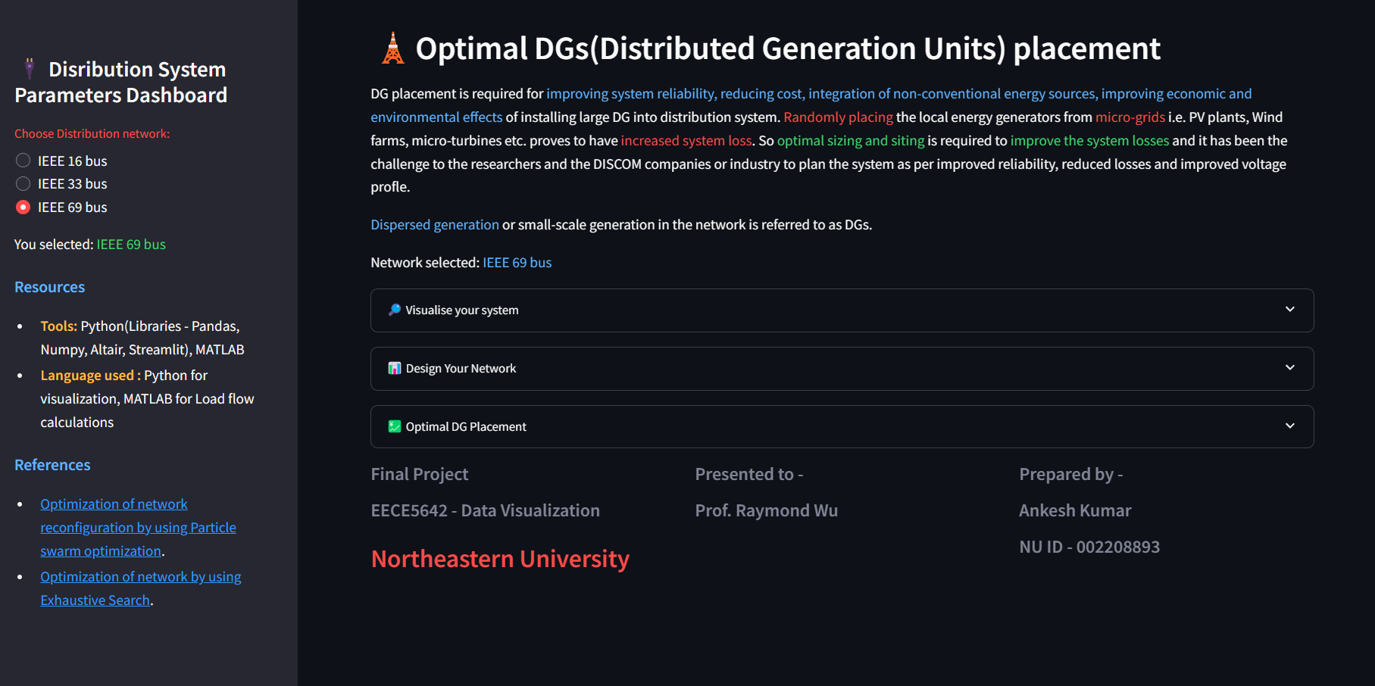
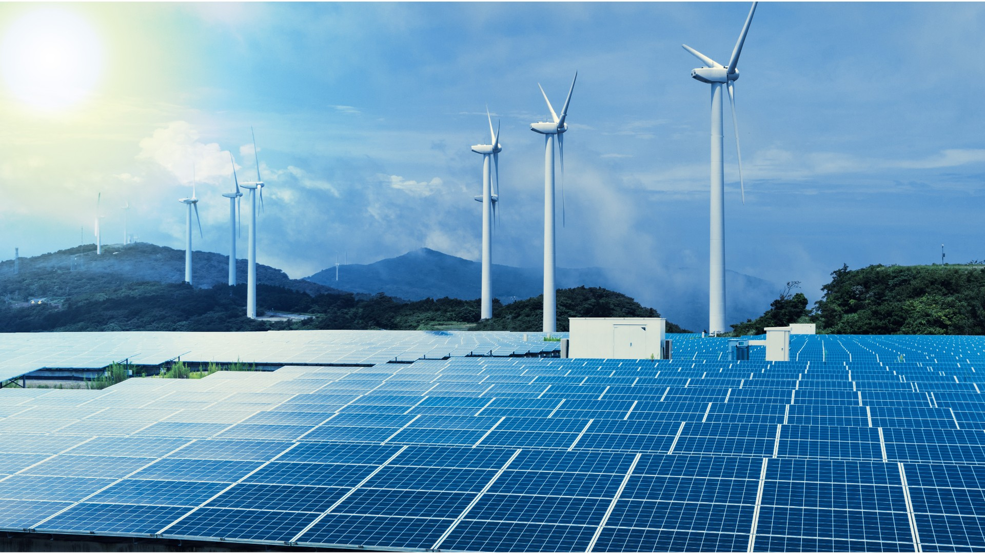
TOOL FRONT-PAGE
- Here user can enter the Distribution network they want to work on (Radio button).
- User can skip to any operation, they are interested in.
PROJECT DEMO

Slide 15
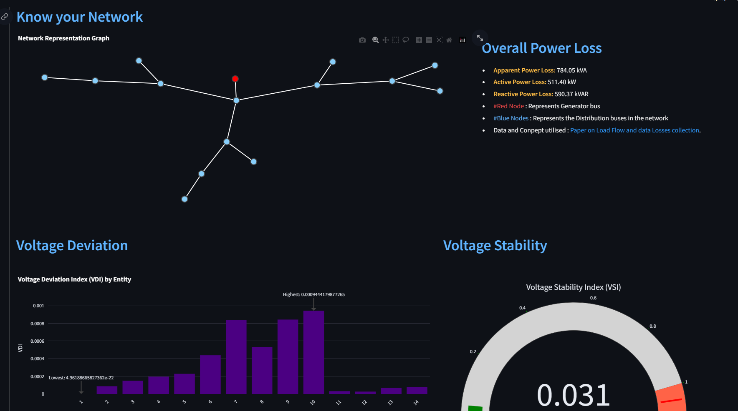
Visualize your system
Hovering-enabled network parameter(Generator bus, Branch Impedance, Bus Power data.
Getting system Loss parameters.
Display Voltage Deviation Index and Voltage Stability Index.
PROJECT DEMO

Slide 16
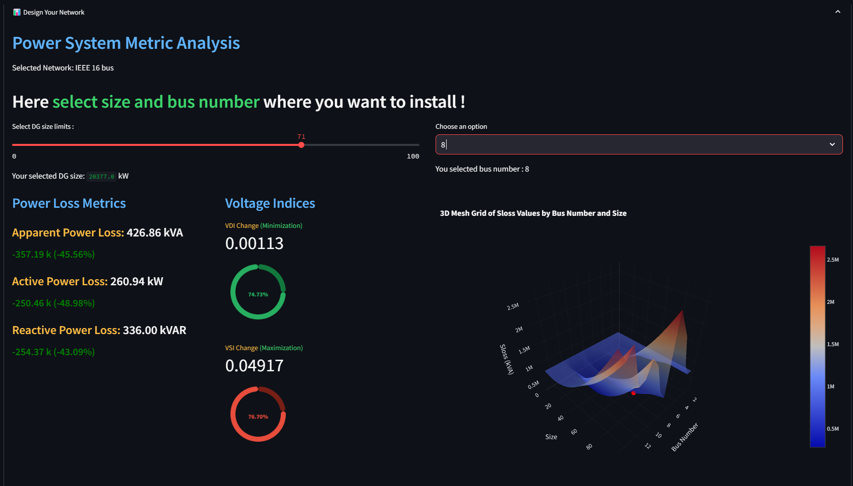
Design your network
Selector to put size of DG and bus number where you want to install.
Get Power Loss Metrics and Voltage Indices.
Display selected system mesh view and red point- to indicate where your solution lies.
PROJECT DEMO

Slide 17
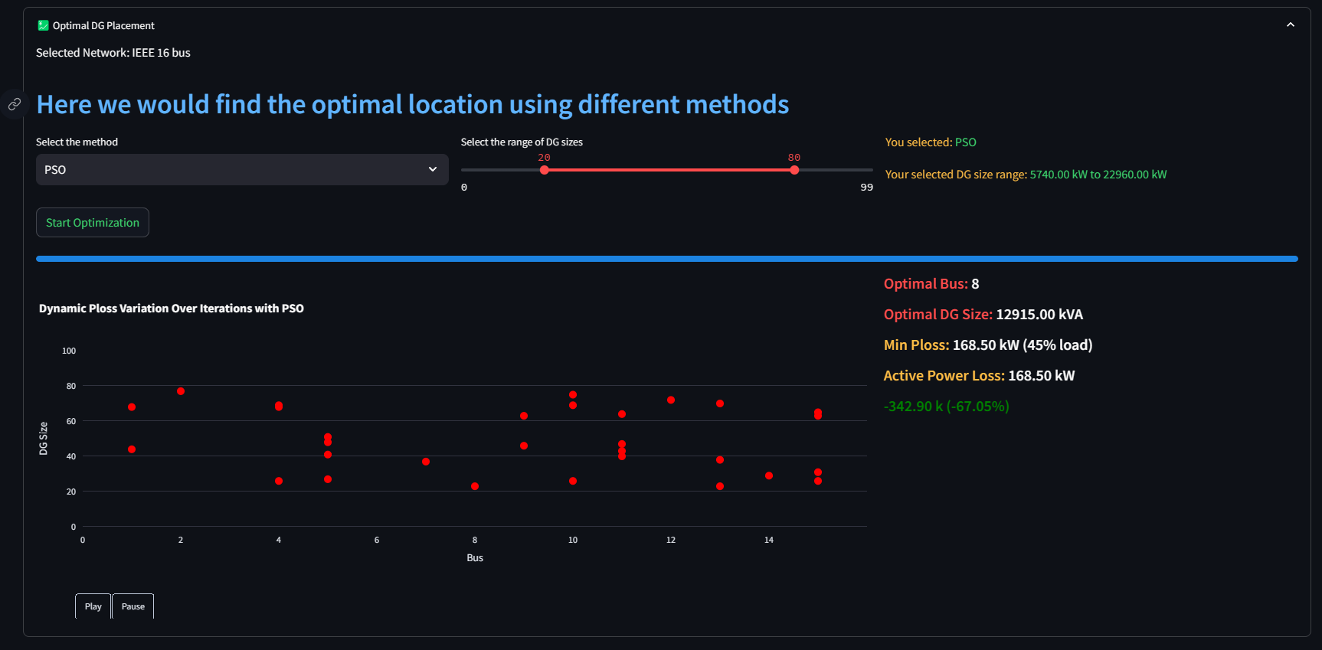
Optimal DG placement
Select the method and Range of DG to be installed.
Get Optimal Power Loss Metrics and Voltage Indices.
Display of Scatter plot to understand the search algorithm behavoiur.
PROJECT DEMO

Slide 18

RESULT AND ANALYSIS

Slide 19
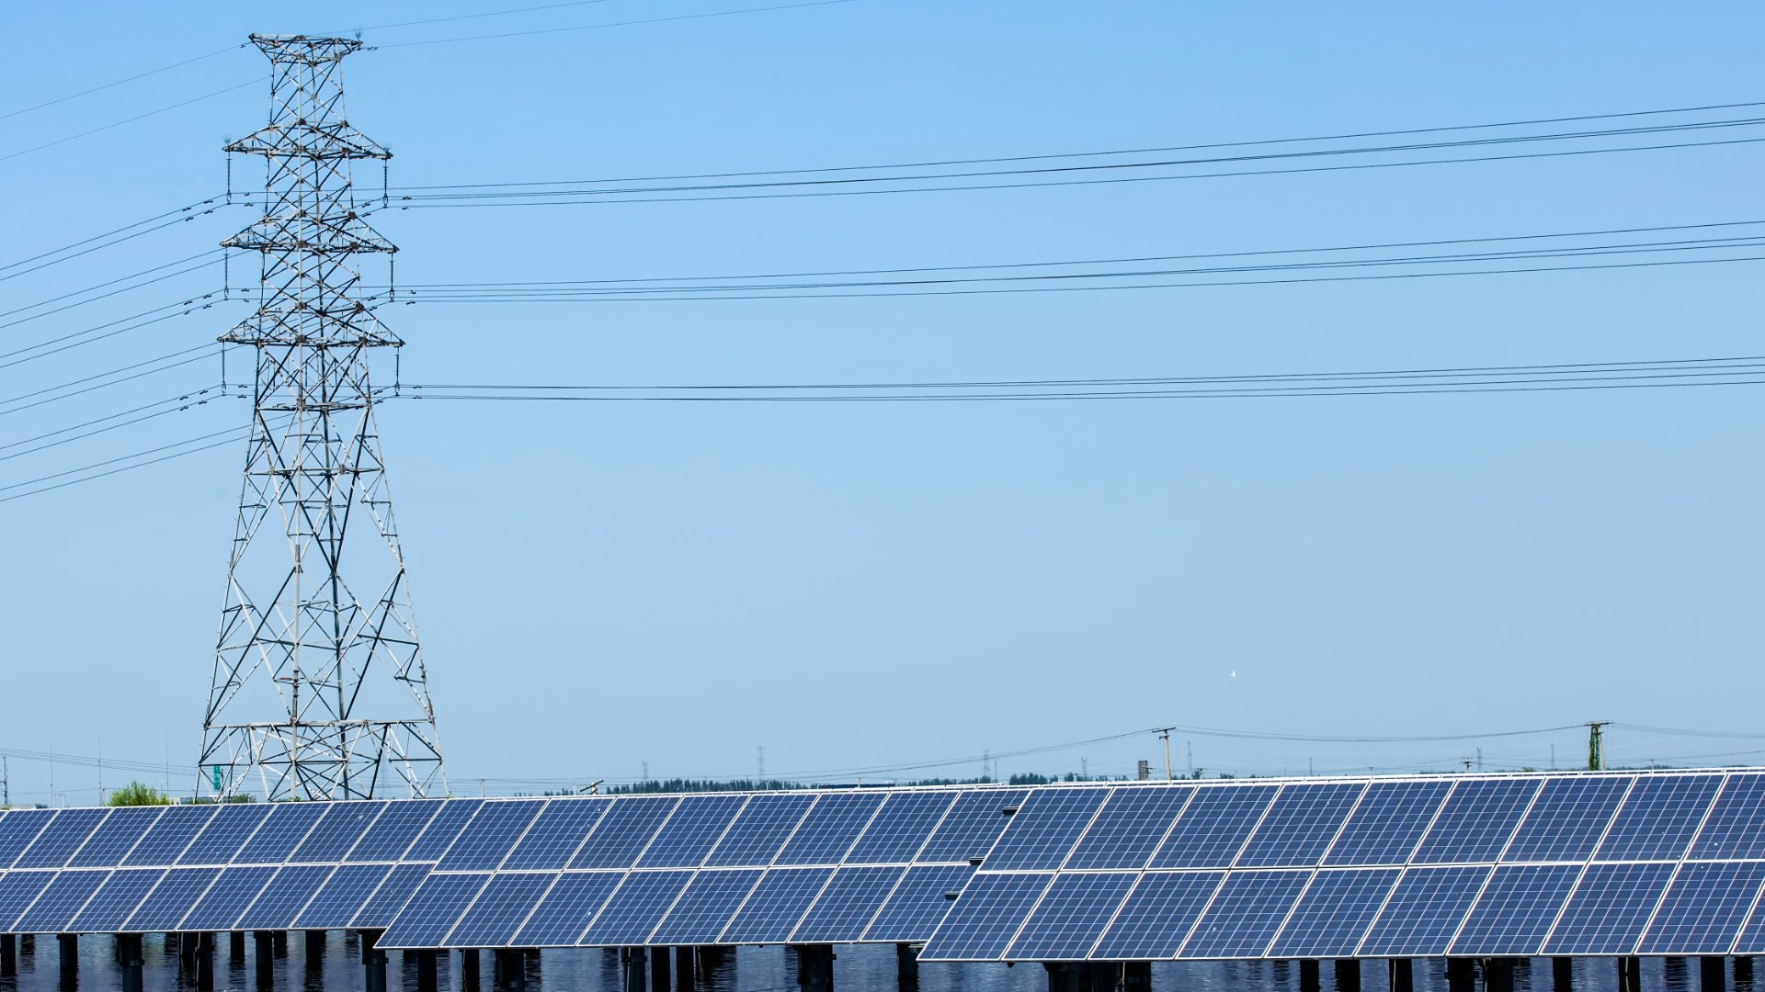
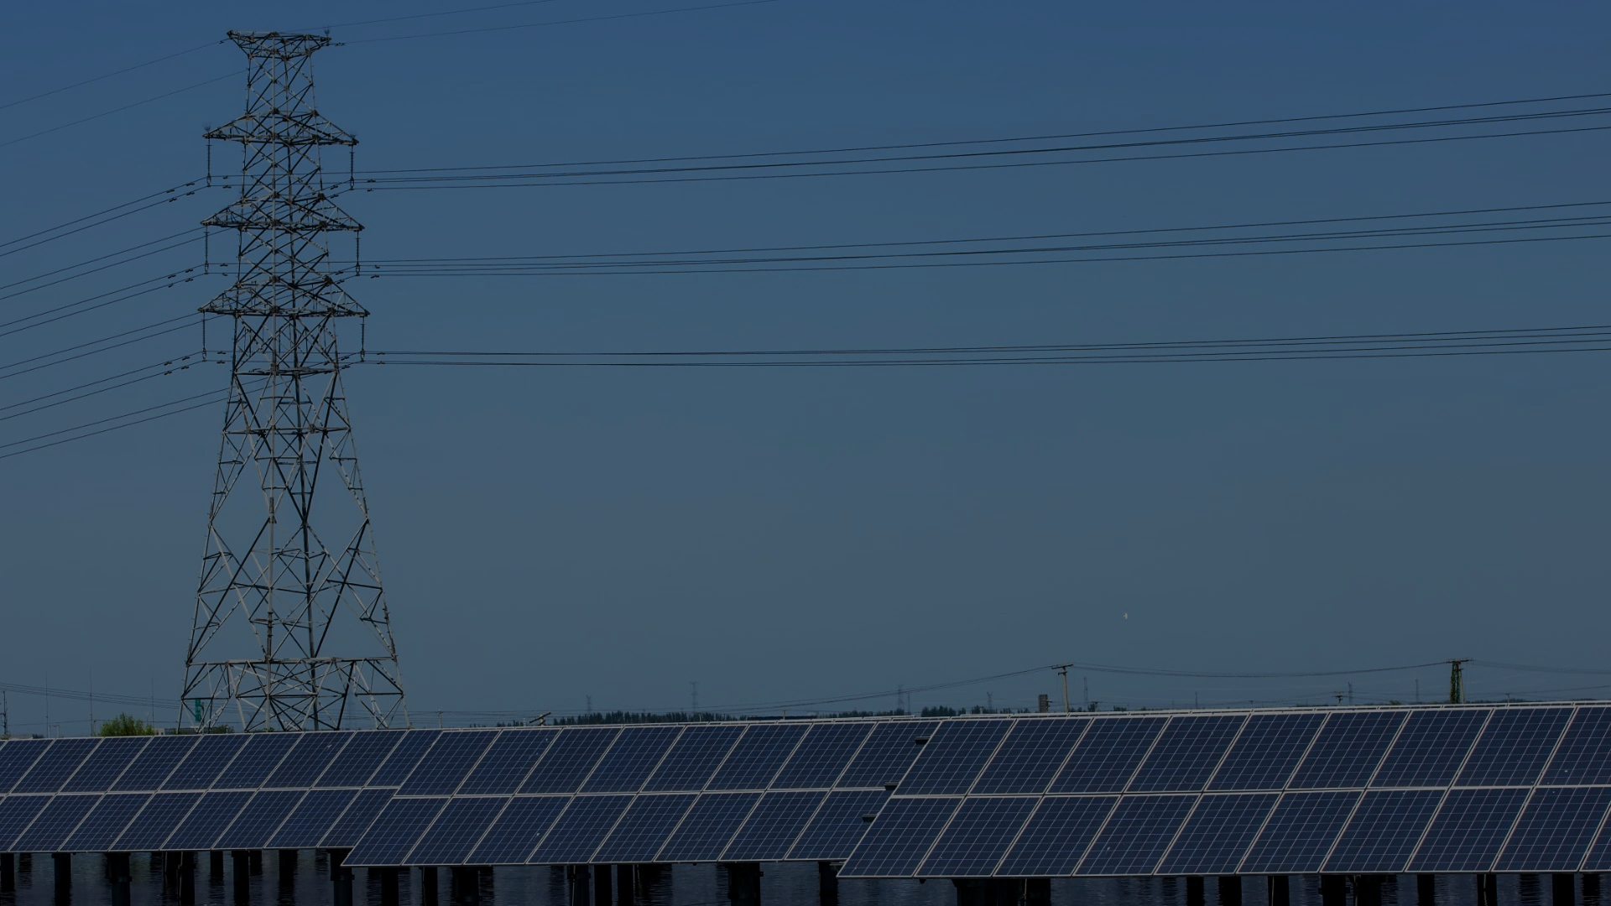
RESULT AND ANALYSIS
Our visualization tool equips users with a robust solution for mapping their power distribution systems and assessing the potential impacts of new Distributed Generator (DG) unit installations.
It enables the visualization of existing infrastructure and predictive scenarios, facilitating strategic planning and decision-making.
Key features of the tool include:
System Visualization: Interactive representation of the current system layout, allowing users to understand the complex network structure and operational flow at a glance.
Impact Analysis: Simulation of potential changes from proposed DG installations, providing insights into their systemic effects and enabling preemptive optimization.
Optimization Algorithm: An adaptive algorithm that delivers optimal solutions for dynamic system configurations, ensuring efficient integration of new units with existing infrastructure.

Slide 20

CONCLUSION

Slide 21


CONCLUSION
Learning best-practices to decide to represent the data based on data meaning, cognition and other better practices.
Analysing different tools to represent for the problem statement.
Utilising open-source tools to develop an open-source platform and providing capability to system planners and DISCOMs to get a visual tool to solve the problem.

Slide 22
CONCLUSION
Recommendations for Further Development:
Data Input Enhancement: Introducing a feature to input system data via files, streamlining the process of system analysis and accommodating user preferences for data management.
Metrics Visualization Improvement: Refining the presentation of system metrics to enhance readability and interpretability, potentially incorporating real-time data visualization techniques.
Algorithm Customization: Offering users the flexibility to adjust key parameters within the optimization algorithm, allowing for tailored solutions that align with specific operational strategies and constraints.
These advancements are projected to further the tool's capacity to serve as an indispensable resource for energy system engineers and decision-makers in the strategic integration of DG units.

Slide 23

Q & A

Slide 24
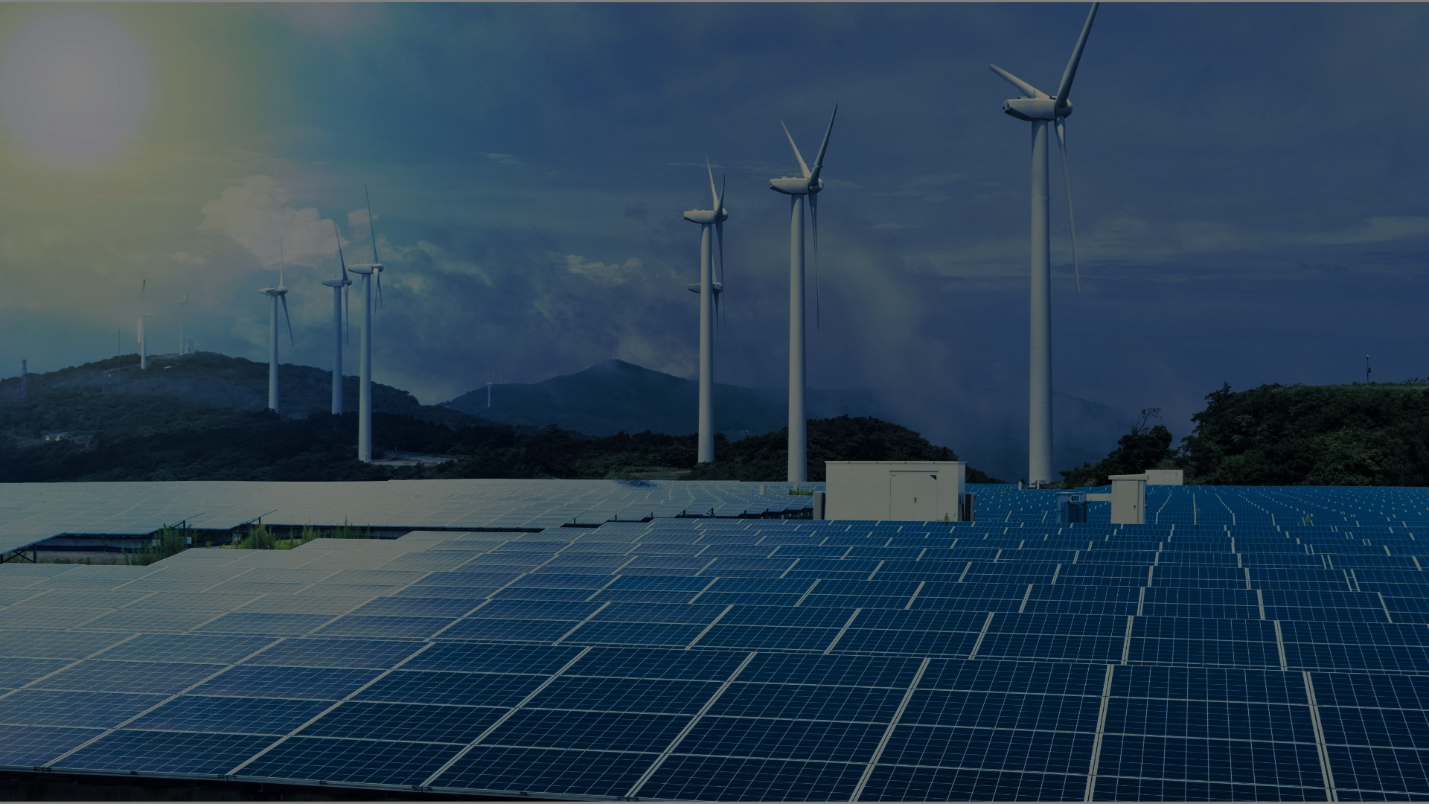
THANKS…

